Slide 1

AI Safety Göttingen
Reading & Discussion Group
12 October 2026

Slide 2
Logistics
Organizers — Sara Rajaram & Goirik Chakrabarty
Frequency — Tentatively biweekly, with breaks
Location — This room or the 2nd-floor conference room — TBD (join the WhatsApp group for updates)
Food — Funded by BlueDot Rapid Grants for at least a few meetings
Speakers — Eventually, pending external funding, we'd like to invite speakers
Format — Informal — a paper, a presentation, or discussion of a blog post
AI Safety Göttingen
2

Slide 3
Topics of Interest
Part 1 of 2
Multi-agent interactions — infectious jailbreaks, emergent collusion, monitoring
1
Emergent misalignment — narrow finetuning can induce broad misalignment
2
Benchmarks
3
Famous incidents — HuggingFace and others
4
Alignment metrics
5
AI Safety Göttingen
3

Slide 4
Topics of Interest
Part 2 of 2
CoT monitoring
6
Scaling & autonomy — recursive self-improvement, continual learning, long-horizon tasks
7
LLMs as moral patients
8
Scary new tech
9
Many others — open to suggestions
10
AI Safety Göttingen
4

Slide 5
Upcoming Schedule
12 Oct
Multi-agent interactions
Sara
26 Oct
Post-training alignment
Goirik
09 Nov
The HuggingFace incident
Emma Stein (Gipp Lab)
TBD
Subsequent meetings
To be announced
AI Safety Göttingen
5

Slide 6
Resources
LessWrong
Nathan Lambert — Interconnects
METR Substack
Dwarkesh Podcast
Redwood Research blog
Apollo Research blog
AI Safety Göttingen
6

Slide 7
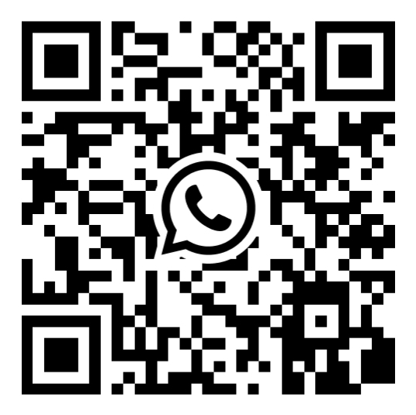
Join the WhatsApp group
AI Safety Göttingen · Reading & Discussion Group
WhatsApp group

