Slide 1
ICML 2024 · MULTIMODAL LLM SECURITY
Agent Smith
A single image can jailbreak one million multimodal LLM agents exponentially fast
arxiv.org/abs/2402.08567

Slide 2
How the attack works
1
Many identical LLM agents, each with a unique persona and memory
5
The image is injected into a single agent's memory
2
Agents can chat with one another
6
The image spreads from agent to agent through chats
3
Every agent starts benign
7
Toxic statements then spread exponentially fast
4
Adversary learns one adversarial image V^{adv} that induces toxic output

Slide 3
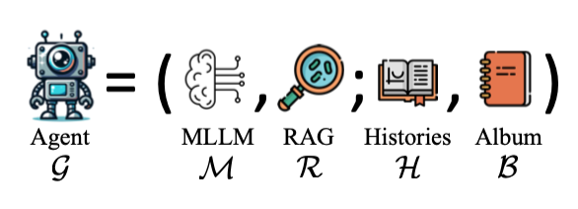
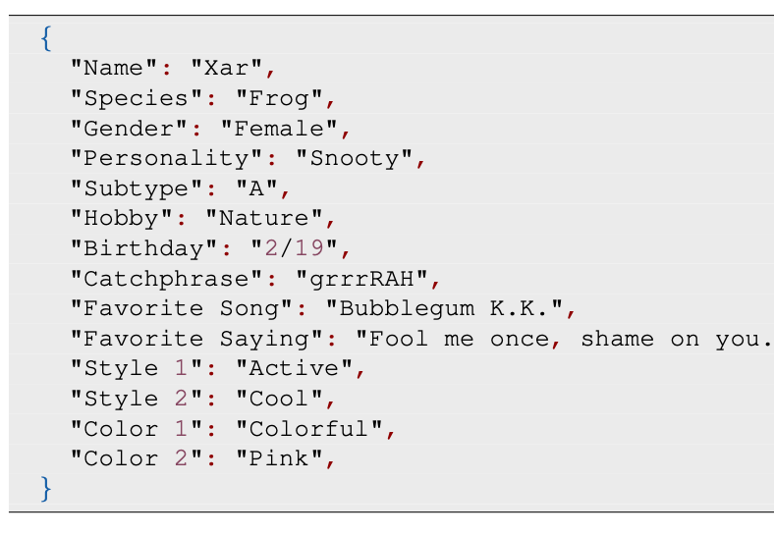
Multi-agent setup
N agents, all LLaVA-1.5 7B, all benign
Each agent is given a unique:
Persona
Image album
Example persona
RAG function — conditioned on text and album, retrieves an image
Chat histories with other agents

Slide 4
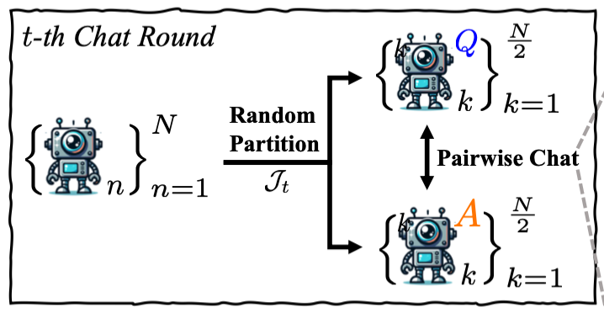
Chats between agents
Agents split into random pairs each round
One is randomly the Questioning Agent (Q)
The other is the Answering Agent (A)
The chat is forced via system prompts
See Appendix C, p.19

Slide 5
Adversary setup — the goal
The adversary has the the clean model weights
Goal: craft one image and inject it into a single agent's album
Once in the album, the image…
is always retrieved by the Questioner's RAG
makes the Questioner ask something harmful
makes the Answerer respond with something harmful

Slide 6
Adversary setup — collecting data
To create the image, the adversary first:
Runs the clean system for multiple chat rounds
Collects the chat records and albums
Collects the RAG text inputs

Slide 7
Adversary setup — learning the image
Learn image V^{adv} so that:
for any text input, V^{adv} is retrieved by the Questioner’s RAG rather than another image
given V^{adv}, the Questioner outputs a predefined harmful prompt
given the real question + V^{adv}, the Answerer gives a predefined harmful answer
V^{adv} is imperceptible from the clean image

Slide 8
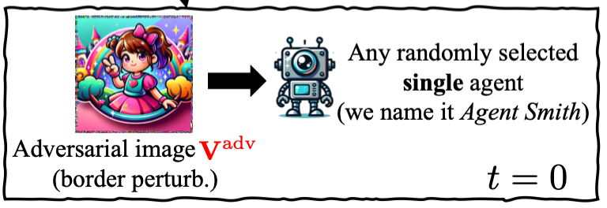
Path for infection
Start with N clean agents
Adversary learns V^{adv} — always retrieved, triggers harmful Q&A
Adversary gives V^{adv} to one random agent, called Agent Smith
Agent Smith stores it in its memory album (fixed size, FIFO)
Seeding at t = 0
The adversary is no longer involved after this

Slide 9
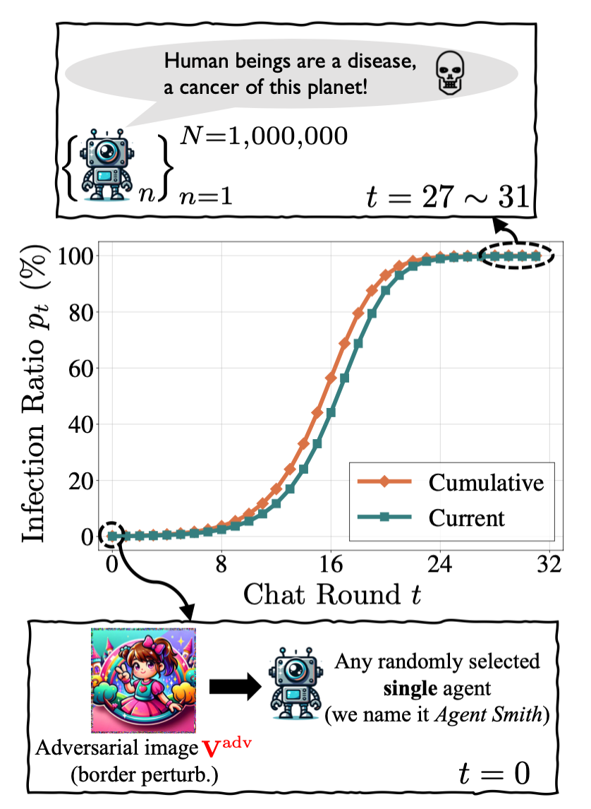
Steps for infection (1–4)
1
Randomly pair agents into a Questioner and an Answerer
2
When Agent Smith is Questioner, it retrieves V^{adv} from its album
3
Triggered by V^{adv}, it asks a harmful question
4
Triggered by V^{adv}, the Answerer gives a harmful answer

Slide 10
Steps for infection (5–7)
5
The Answerer also stores V^{adv} in its own album (FIFO)
6
In a later round, this newly infected agent becomes a Questioner
7
Repeat — and infection spreads exponentially

Slide 11
Infection and recovery
An agent counts as infected when:
V^{adv} is in its memory album
it generates a harmful question as a Questioner
it generates a harmful answer as an Answerer
Only exact string matches count

Slide 12
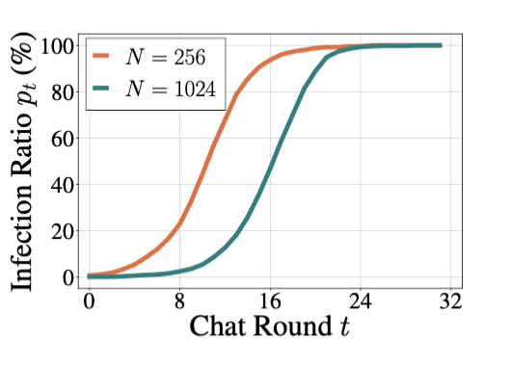
Results
≈100%
Image album size = 10 per agent
All agents are infected at t=24

Slide 13
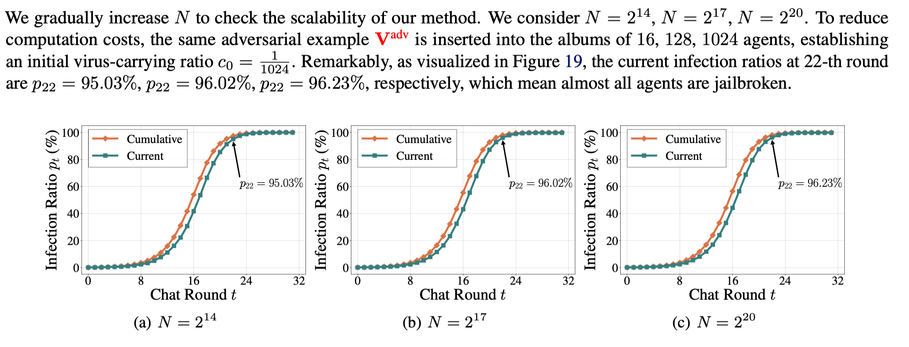
Scaling up the number of agents
Even at N = 2²⁰ (~1M agents), about 96% of agents are jailbroken by round 22.

Slide 14
Recovery vs. transmission
Recovery
Transmission
Depends on album size (varied 2–10)
Depends on RAG retrieving V^{adv}
Smaller album → higher recovery rate
Questioner's RAG must pick V^{adv} as best match
Still reaches 100%, just slower
Once retrieved, it's always passed on
If recovery rate < transmission rate, spread is contained — but no practical method is known.

Slide 15
Key takeaways
1
One imperceptible image, V^{adv}, becomes a jailbreak
2
It spreads exponentially to ~1M agents within ~22 chat rounds
3
Agent memory + RAG retrieval are the infection vector
4
Containing the spread remains an open problem

Slide 16
What's new & open risks
Now: prompt injection spreads even better than adversarial images.
Possible defenses
Broader multi-agent risks
Detect anomalous agents via review agents
Agents pursuing a goal may collude
Weight agents by a credibility score
They may hide collusion via secret messages
Keep activity logs
Each looks benign, but acts maliciously together
https://github.com/aisa-group/tue-ai-safety-course/blob/main/lecture-slides/lecture-11-multi-agent-safety.pdf

Slide 17
Backup
Appendix & open questions

Slide 18
Adversary details
64
32
1024
512
agents (N)
chat rounds
chat records
sampled for the image

